Slide 1
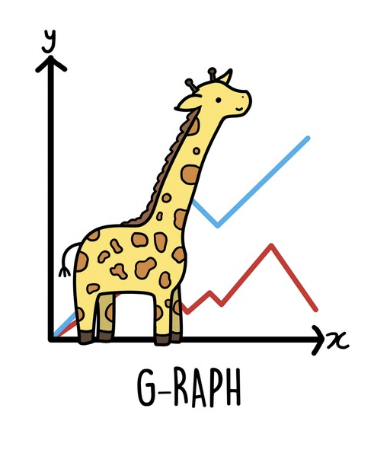
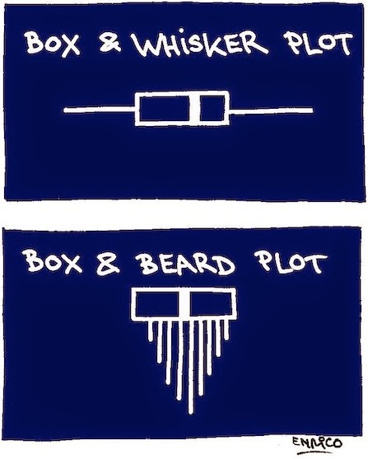
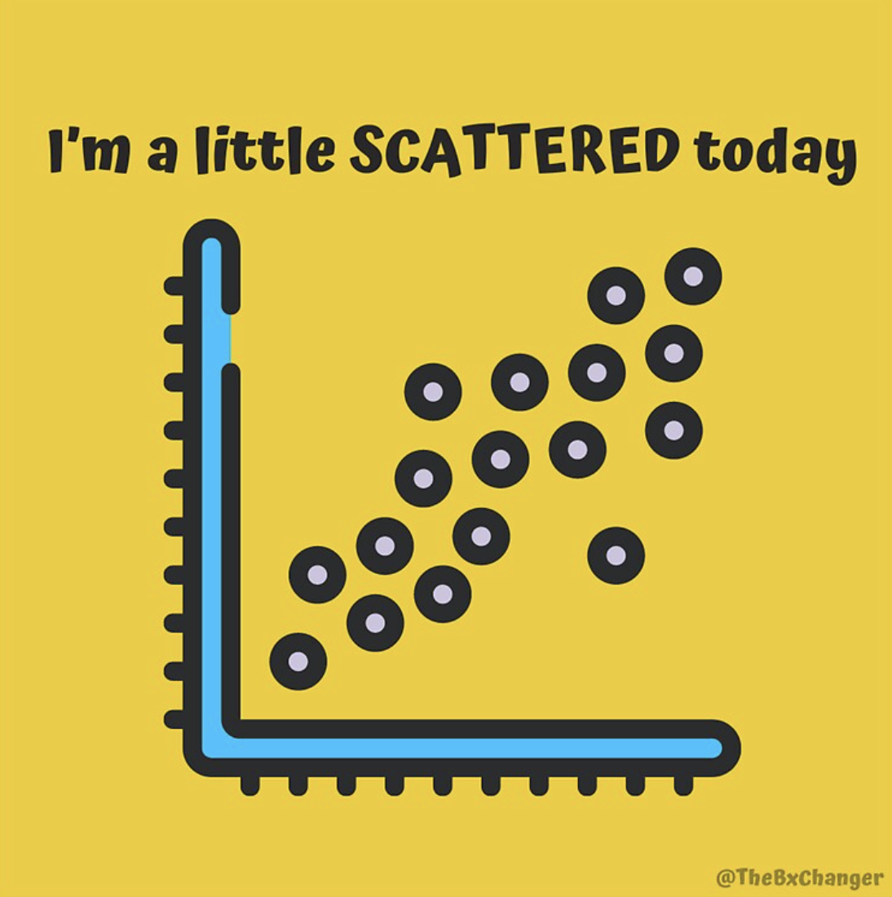
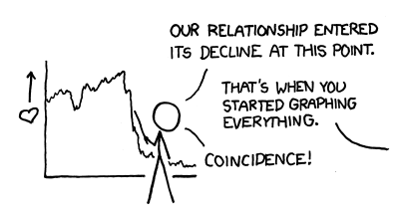

Data 100
Discussion #4
February 15th, 2023
Sign in here: https://tinyurl.com/data100-sp23-dis
Password: rahul4
Credit to Bella for these slides lol
Slides: https://tinyurl.com/rahul-slides
P.S. Add memes to Ed thread!!

Slide 2
Announcements 🎉
HW #4 is due 2/16 at 11:59 pm
Exam prep sections no longer have sign-ups – attend any section you would like
Linear Algebra overview session 2/17 at 2:30 pm on Zoom
Slides: https://tinyurl.com/rahul-slides

Slide 3
Data Visualization

Slide 4
Plotting Pipelines 📈
In Data 100, we will mostly use the Matplotlib and Seaborn plotting libraries
Matplotlib
Seaborn
In Matplotlib, we always plot arrays of X and Y
In Seaborn, we can plot arrays of X and Y…
my_plot = sns.plotting_function(x=x_array, y=y_array)
plt.plotting_function(x=x_array, y=y_array)
…or reference the columns of a DataFrame
plt.xlabel(“x_label”)
plt.ylabel(“y_label”)
plt.title(“title”);
my_plot = sns.plotting_function(data = df, \ x=“col_x”, y=“col_y”)
plt.xlabel(“x_label”)
plt.ylabel(“y_label”)
plt.title(“title”);

Slide 5
Picking Which Plot ⛏️
How do we know what kind of plot to use? What should plotting_function be?
I am plotting two quantitative continuous variables.
Scatter plot
2D KDE plot
I am plotting a qualitative variable and a quantitative continuous variable.
Overlaid histograms
Side-by-side box/violinplots
I am plotting a qualitative variable and a quantitative discrete variable.
Bar chart
I am plotting time data.
Line plot

Slide 6
What makes a good visualization? 💯
Clear title, axis labels, and legend
If I had never seen this visualization before, would I be able to tell what it is displaying?
Appropriate scale
Can I easily tell how large quantitative values are? Are units consistent?
Uses a uniform colormap
Do colors accurately capture differences in value? Are they legible?
Doesn’t rely on angles or areas
Can I compare values at a quick glance? (humans are very bad at gauging areas/angles!)
Tip: these are questions that Readers ask themselves when grading your homework!

Slide 7
Never, ever use a pie chart.
(you would be surprised how often this comes up in exams)

Slide 8
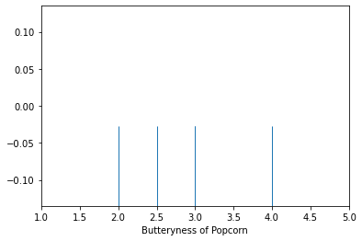
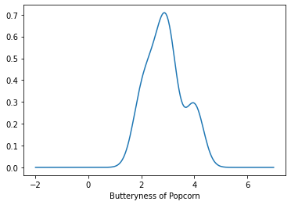
Kernel Density Estimation 🍿
KDE takes in data points that we’ve collected and tries to guess the probability density function of the data
In other words: can we approximate the probability distribution that generated our data?

Slide 9
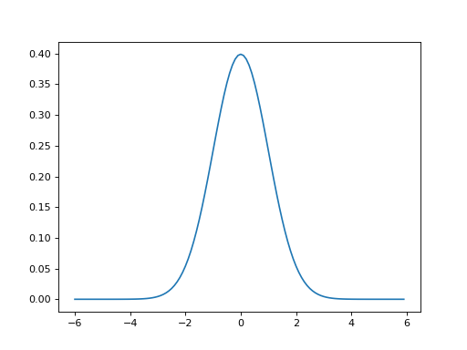
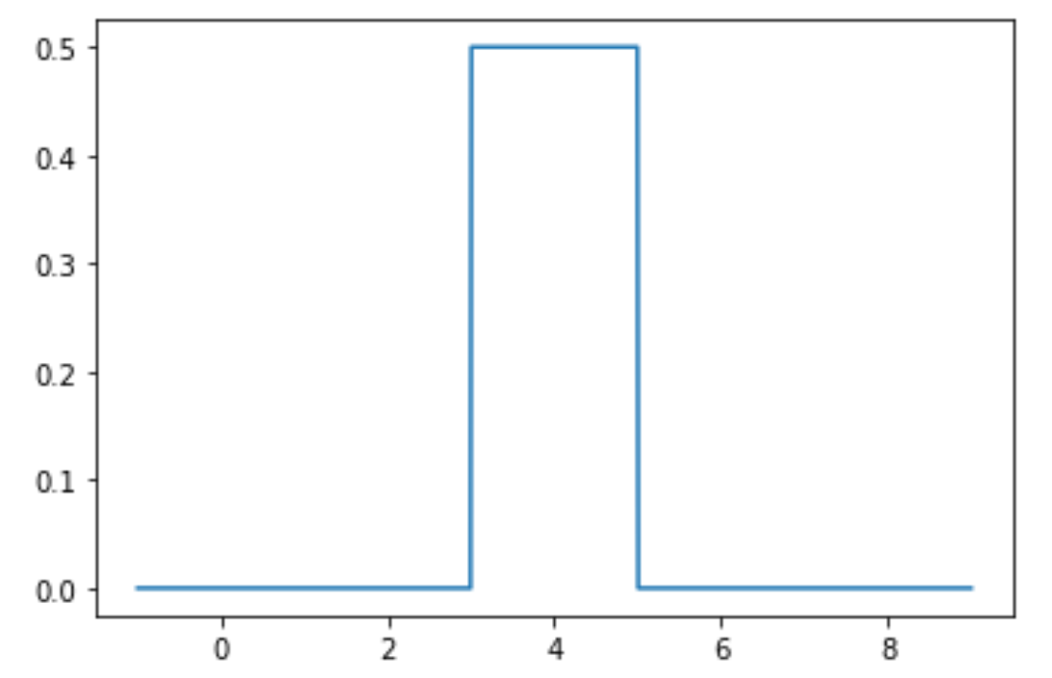
Kernel Density Estimation 🍿
We first choose a kernel – a function that decides how much weight to give each data point in the final smoothed curve
Gaussian kernel Boxcar kernel

Slide 10

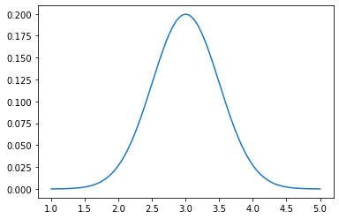
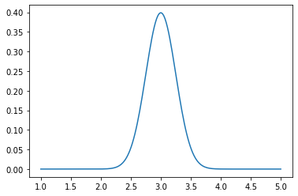
Kernel Density Estimation 🍿
We then choose the bandwidth ( ), a number representing how “smooth” to make our curve
In a Gaussian kernel, the bandwidth is the standard deviation of the normal curve
= 0.5
= 0.25

Slide 11
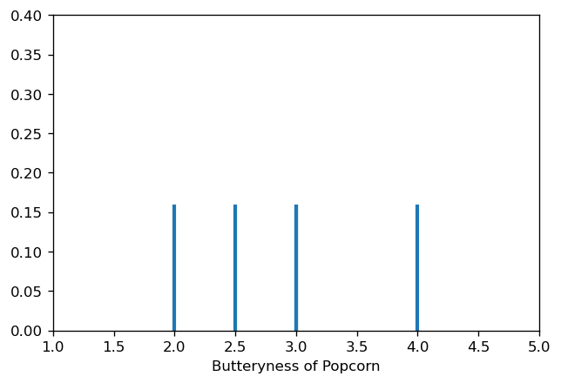
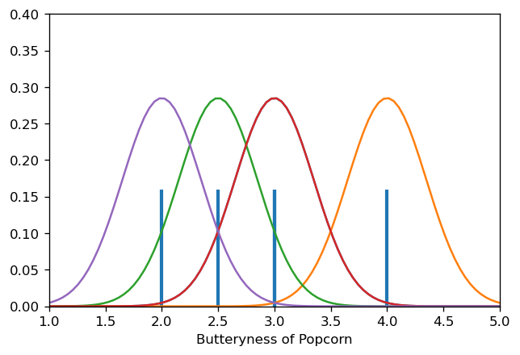
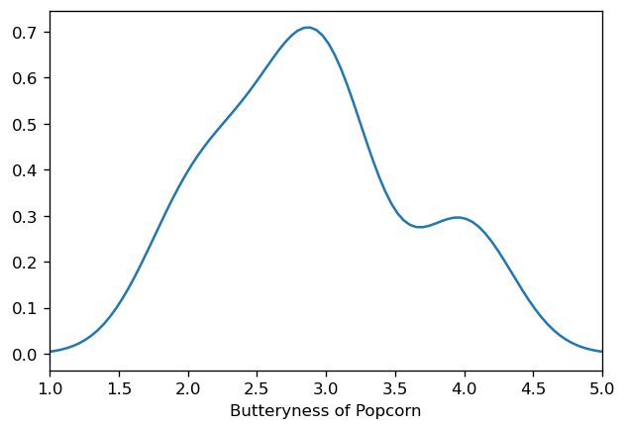
Kernel Density Estimation 🍿
Place one normalized kernel at each data point…
…then sum

Slide 12
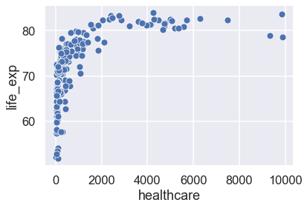
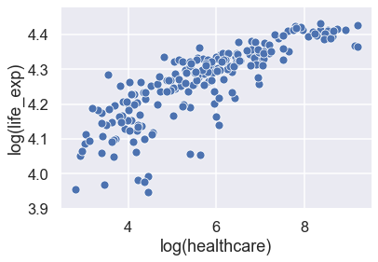
Transforming data 💪
Linear relationships are easiest to model – we’ll learn about this when we study linear regression later this week
If our data has a complicated pattern, we can transform it to have a linear form

Slide 13
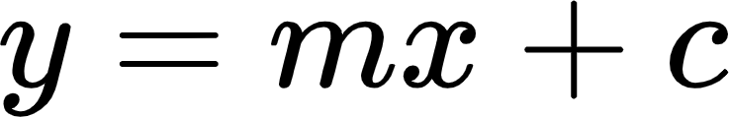
Transforming data 💪
We know that a linear relationship has the form
Our x variable is log(healthcare).
Our y variable is log(life_exp).
Let’s try plugging this in:
If we rearrange our equation, we can express healthcare in terms of life_exp
(we’ll do this during the worksheet!)
This means that we used our linear transformation to find a new pattern in the data

Slide 14
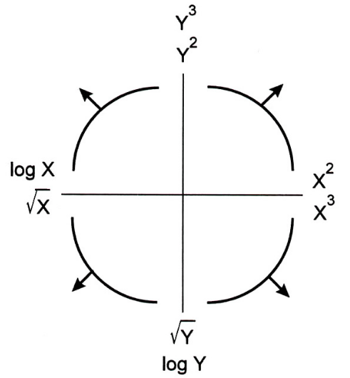
Tukey-Mosteller Bulge Diagram 🦃
…transform y by this
If the data bulges like this…
…or transform x by this
This is a very, very common exam question

Slide 15
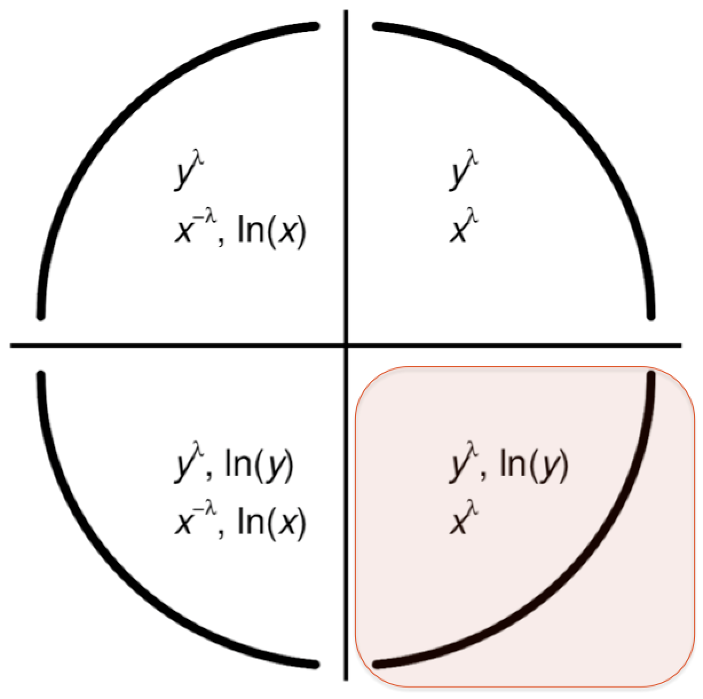
Better Tukey Bulge Diagram 🦃
This is a very, very common exam question

Slide 16
The Bigger Picture

Slide 17
Visualization checklist:
Title
Axis labels
Legend
No overplotting
Uniform colormap
No angles/areas
Visualization variables:
Quantitative continuous + quantitative continuous
Scatterplot, 2D KDE plot
Quantitative discrete/qualitative + quantitative continuous
Side-by-side boxplot, side-by-side violin plot, overlaid histograms
Time sequence + quantitative continuous
Line plot
Kernel density estimation
What is it? A way of creating a smooth curve from datapoints
Why do we care? KDEs help us create smooth, interpretable visualizations
Data linearization/transformation
What is it? Transforming one axis of our dataset so the overall data becomes linear
Why do we care? A linear dataset sets us up to be able to use linear regression as a modeling tool
Tukey-Mosteller Bulge Diagram
What is it? A visual guide to how to choose transformations for linearization
Why do we care? Very helpful when making transformation choices – know this for exams!

